Slide 1
Modern GPU Architecture
CSE 694G
Game Design and Project
Prof. Roger Crawfis

Slide 2
GPU vs CPU
A GPU is tailored for highly parallel operation while a CPU executes programs serially
For this reason, GPUs have many parallel execution units and higher transistor counts, while CPUs have few execution units and higher clockspeeds
A GPU is for the most part deterministic in its operation (though this is quickly changing)
GPUs have much deeper pipelines (several thousand stages vs 10-20 for CPUs)
GPUs have significantly faster and more advanced memory interfaces as they need to shift around a lot more data than CPUs

Slide 3
The GPU pipeline
The GPU receives geometry information from the CPU as an input and provides a picture as an output
Let’s see how that happens
host
interface
vertex
processing
triangle
setup
pixel
processing
memory
interface

Slide 4
Host Interface
The host interface is the communication bridge between the CPU and the GPU
It receives commands from the CPU and also pulls geometry information from system memory
It outputs a stream of vertices in object space with all their associated information (normals, texture coordinates, per vertex color etc)
host
interface
vertex
processing
triangle
setup
pixel
processing
memory
interface

Slide 5
Vertex Processing
The vertex processing stage receives vertices from the host interface in object space and outputs them in screen space
This may be a simple linear transformation, or a complex operation involving morphing effects
Normals, texcoords etc are also transformed
No new vertices are created in this stage, and no vertices are discarded (input/output has 1:1 mapping)
host
interface
vertex
processing
triangle
setup
pixel
processing
memory
interface

Slide 6
Triangle setup
In this stage geometry information becomes raster information (screen space geometry is the input, pixels are the output)
Prior to rasterization, triangles that are backfacing or are located outside the viewing frustrum are rejected
Some GPUs also do some hidden surface removal at this stage
host
interface
vertex
processing
triangle
setup
pixel
processing
memory
interface

Slide 7
Triangle Setup (cont)
A fragment is generated if and only if its center is inside the triangle
Every fragment generated has its attributes computed to be the perspective correct interpolation of the three vertices that make up the triangle
host
interface
vertex
processing
triangle
setup
pixel
processing
memory
interface

Slide 8
Fragment Processing
Each fragment provided by triangle setup is fed into fragment processing as a set of attributes (position, normal, texcoord etc), which are used to compute the final color for this pixel
The computations taking place here include texture mapping and math operations
Typically the bottleneck in modern applications
host
interface
vertex
processing
triangle
setup
pixel
processing
memory
interface

Slide 9
Memory Interface
Fragment colors provided by the previous stage are written to the framebuffer
Used to be the biggest bottleneck before fragment processing took over
Before the final write occurs, some fragments are rejected by the zbuffer, stencil and alpha tests
On modern GPUs, z and color are compressed to reduce framebuffer bandwidth (but not size)
host
interface
vertex
processing
triangle
setup
pixel
processing
memory
interface

Slide 10
Programmability in the GPU
Vertex and fragment processing, and now triangle set-up, are programmable
The programmer can write programs that are executed for every vertex as well as for every fragment
This allows fully customizable geometry and shading effects that go well beyond the generic look and feel of older 3D applications
host
interface
vertex
processing
triangle
setup
pixel
processing
memory
interface

Slide 11
Diagram of a modern GPU
Input from CPU
Host interface
Vertex processing
Triangle setup
Pixel processing
Memory Interface
64bits to
memory
64bits to
memory
64bits to
memory
64bits to
memory

Slide 12
CPU/GPU interaction
The CPU and GPU inside the PC work in parallel with each other
There are two “threads” going on, one for the CPU and one for the GPU, which communicate through a command buffer:
GPU reads commands from here
Pending GPU commands
CPU writes commands here

Slide 13
CPU/GPU interaction (cont)
If this command buffer is drained empty, we are CPU limited and the GPU will spin around waiting for new input. All the GPU power in the universe isn’t going to make your application faster!
If the command buffer fills up, the CPU will spin around waiting for the GPU to consume it, and we are effectively GPU limited

Slide 14
CPU/GPU interaction (cont)
Another important point to consider is that programs that use the GPU do not follow the traditional sequential execution model
In the CPU program below, the object is not drawn after statement A and before statement B:
Instead, all the API call does, is to add the command to draw the object to the GPU command buffer
Statement A
API call to draw object
Statement B

Slide 15
Synchronization issues
This leads to a number of synchronization considerations
In the figure below, the CPU must not overwrite the data in the “yellow” block until the GPU is done with the “black” command, which references that data:
GPU reads commands from here
CPU writes commands here
data

Slide 16
Syncronization issues (cont)
Modern APIs implement semaphore style operations to keep this from causing problems
If the CPU attempts to modify a piece of data that is being referenced by a pending GPU command, it will have to spin around waiting, until the GPU is finished with that command
While this ensures correct operation it is not good for performance since there are a million other things we’d rather do with the CPU instead of spinning
The GPU will also drain a big part of the command buffer thereby reducing its ability to run in parallel with the CPU

Slide 17
Inlining data
One way to avoid these problems is to inline all data to the command buffer and avoid references to separate data:
However, this is also bad for performance, since we may need to copy several Mbytes of data instead of merely passing around a pointer
GPU reads commands from here
data
CPU writes commands here

Slide 18
Renaming data
A better solution is to allocate a new data block and initialize that one instead, the old block will be deleted once the GPU is done with it
Modern APIs do this automatically, provided you initialize the entire block (if you only change a part of the block, renaming cannot occur)
Better yet, allocate all your data at startup and don’t change them for the duration of execution (not always possible, however)
data
data
data
data

Slide 19
GPU readbacks
The output of a GPU is a rendered image on the screen, what will happen if the CPU tries to read it?
The GPU must be syncronized with the CPU, ie it must drain its entire command buffer, and the CPU must wait while this happens
GPU reads commands from here
Pending GPU commands
CPU writes commands here

Slide 20
GPU readbacks (cont)
We lose all parallelism, since first the CPU waits for the GPU, then the GPU waits for the CPU (because the command buffer has been drained)
Both CPU and GPU performance take a nosedive
Bottom line: the image the GPU produces is for your eyes, not for the CPU (treat the CPU -> GPU highway as a one way street)

Slide 21
Some more GPU tips
Since the GPU is highly parallel and deeply pipelined, try to dispatch large batches with each drawing call
Sending just one triangle at a time will not occupy all of the GPU’s several vertex/pixel processors, nor will it fill its deep pipelines
Since all GPUs today use the zbuffer algorithm to do hidden surface removal, rendering objects front-to-back is faster than back-to-front (painters algorithm), or random ordering
Of course, there is no point in front-to-back sorting if you are already CPU limited

Slide 22
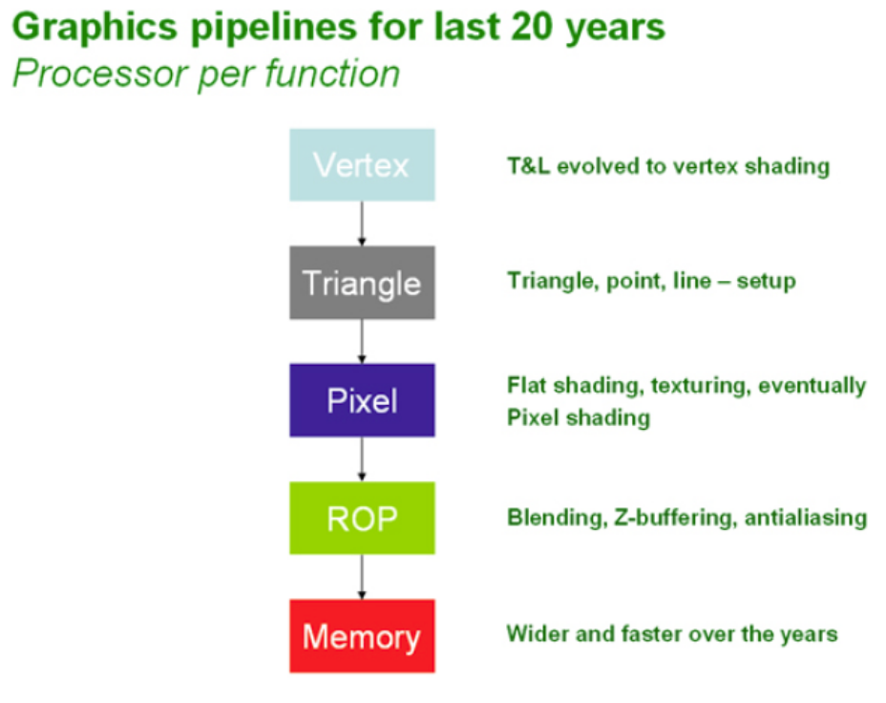
Graphics Hardware Abstraction
OpenGL and DirectX provide an abstraction of the hardware.

Slide 23
Trend from pipeline to data parallelism
Coord, normal
Transform
Coordinate
Transform
Command Processor
Lighting
Clip testing
Clipping state
6-plane
Frustum
Clipping
Round-robin Aggregation
Divide by w
(clipping)
Viewport
Prim. Assy.
Backface cull
Divide by w
Viewport
Clark “Geometry Engine”
(1983)
SGI 4D/GTX
(1988)
SGI RealityEngine
(1992)

Slide 24
Queueing
Application
FIFO buffering (first-in, first-out) is provided between task stages
  Accommodates variation in execution time
  Provides elasticity to allow unified load balancing to work
FIFOs can also be unified
  Share a single large memory with multiple head-tail pairs
  Allocate as required
Vertex assembly
FIFO
Vertex operations
FIFO
Primitive assembly
FIFO

Slide 25
Data locality
Application
Prior to texture mapping:
  Vertex pipeline was a stream processor
  Each work element (vertex, primitive, fragment) carried all the state it needed
  Modal state was local to the pipeline stage
  Assembly stages operated on adjacent work elements
  Data locality was inherent in this model
Post texture mapping:
  All application-programmable stages have memory access (and use them)
    So the vertex pipeline is no longer a stream processor
  Data locality must be fought for …
Vertex assembly
Vertex operations
Primitive assembly
Primitive operations
Rasterization
Fragment operations
Framebuffer
Display

Slide 26
Post-texture mapping data locality
(simplified)
Modern memory (DRAM) operates in large blocks
  Memory is a 2-D array
  Access is to an entire row
To make efficient use of memory bandwidth all the data in a block must be used
Two things can be done:
  Aggregate read and write requests
    Memory controller and cache
    Complex part of GPU design
  Organize memory contents coherently (blocking)

Slide 27
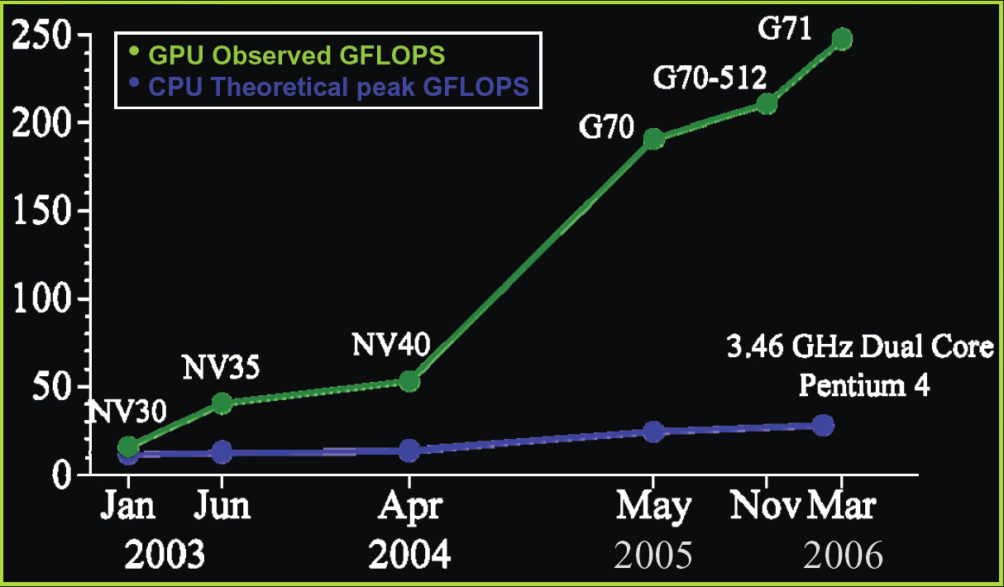
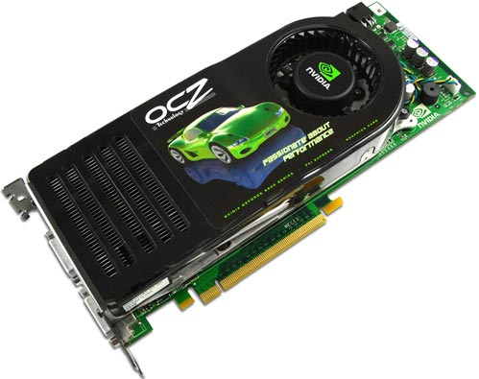
The nVidia G80 GPU
128 streaming floating point processors @1.5Ghz
1.5 Gb Shared RAM with 86Gb/s bandwidth
500 Gflop on one chip (single precision)

Slide 28
Why are GPU’s so fast?
Entertainment Industry has driven the economy of these chips?
  Males age 15-35 buy
  $10B in video games / year
Moore’s Law ++
Simplified design (stream processing)
Single-chip designs.

Slide 29
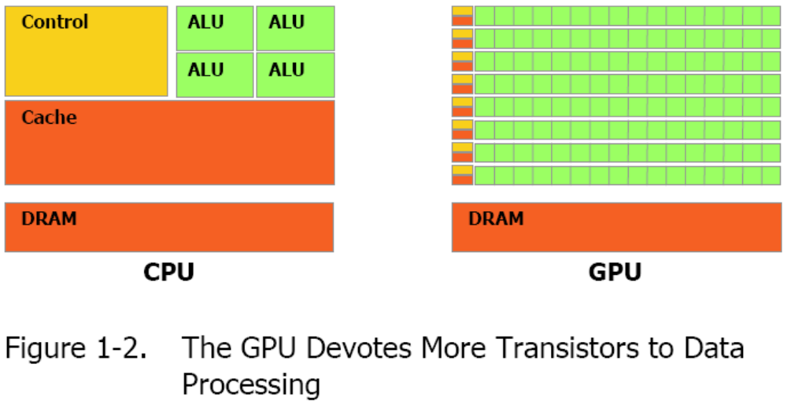
Modern GPU has more ALU’s

Slide 30
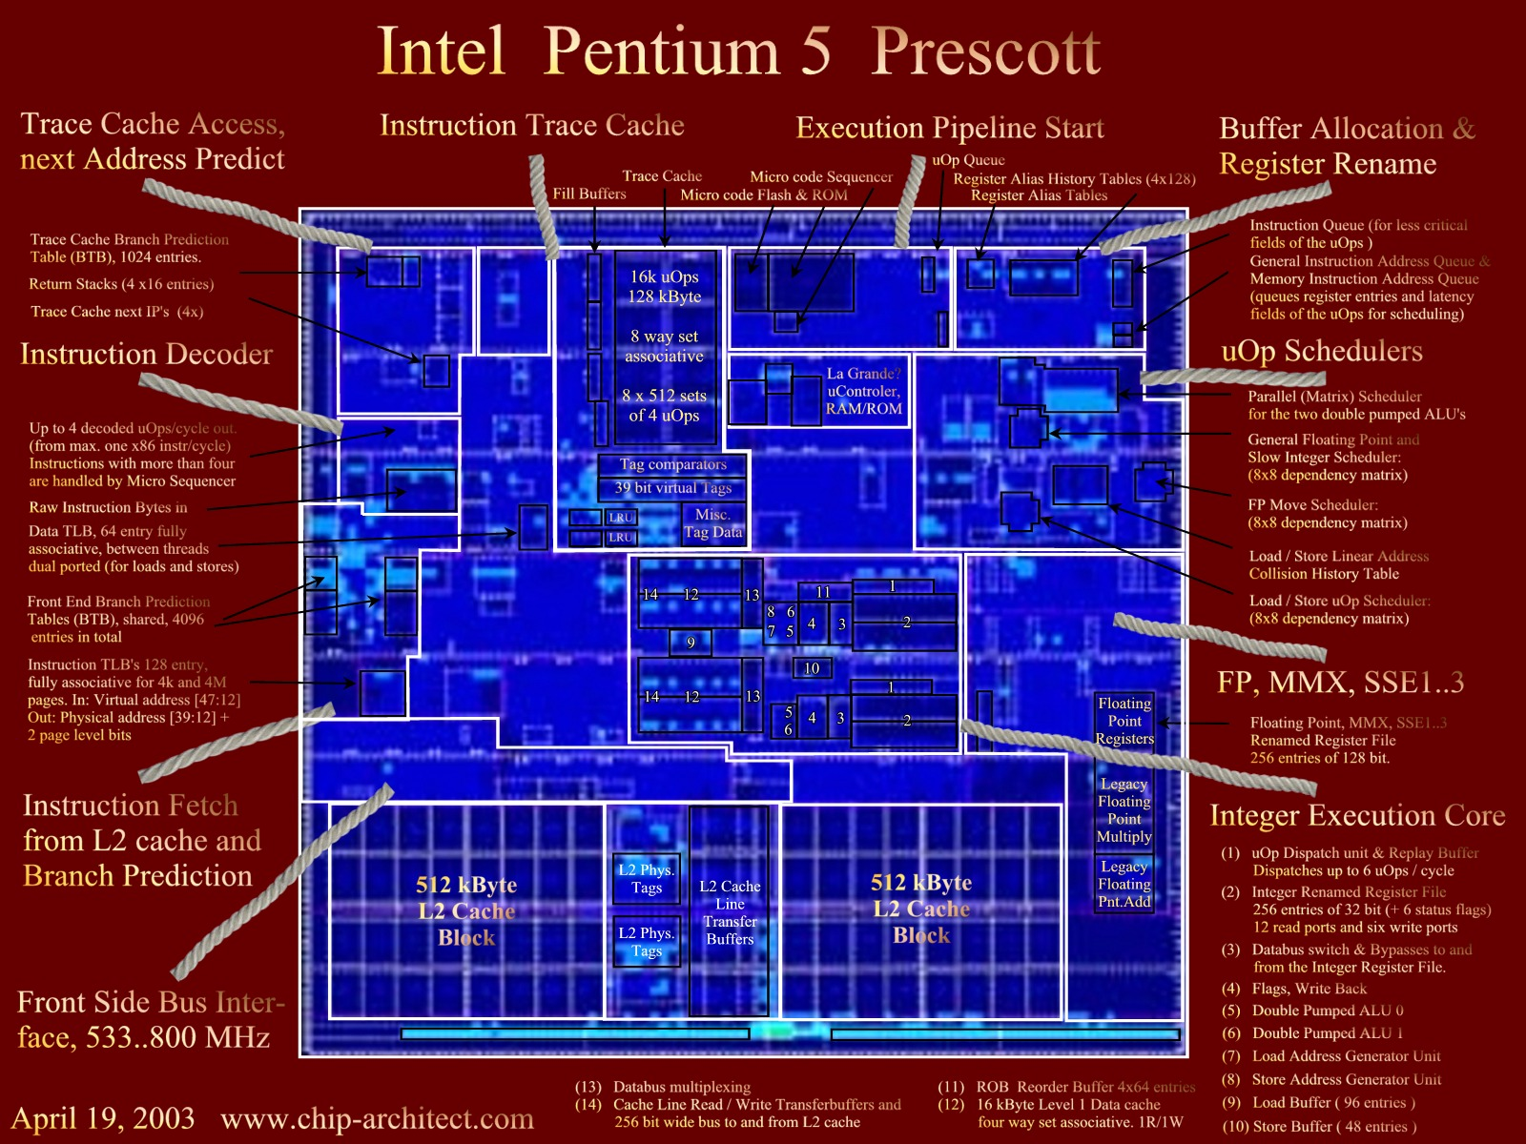

Slide 31
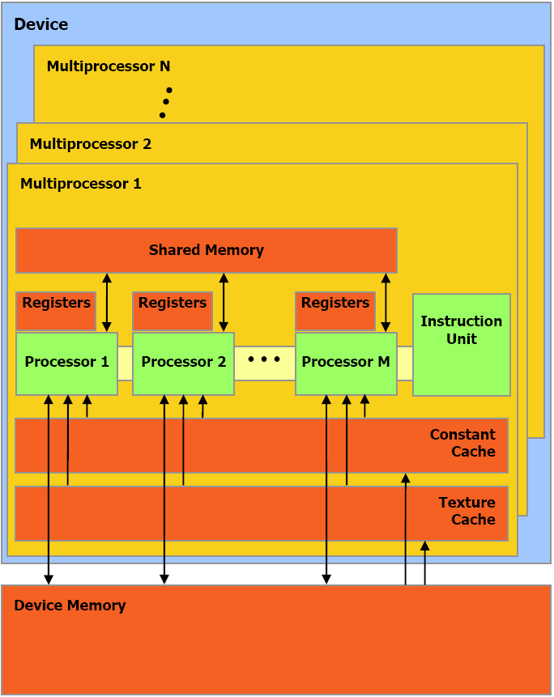
nVidia G80 GPU Architecture Overview
16 Multiprocessors Blocks
Each MP Block Has:
  8 Streaming Processors (IEEE 754 spfp compliant)
  16K Shared Memory
  64K Constant Cache
  8K Texture Cache
Each processor can access all of the memory at 86Gb/s, but with different latencies:
Shared – 2 cycle latency
Device – 300 cycle latency

Slide 32
A Specialized Processor
Very Efficient For
  Fast Parallel Floating Point Processing
  Single Instruction Multiple Data Operations
  High Computation per Memory Access
Not As Efficient For
  Double Precision
  Logical Operations on Integer Data
  Branching-Intensive Operations
  Random Access, Memory-Intensive Operations

Slide 33
Implementation = abstraction (from lecture 2)
Application
Application
Data Assembler
Setup / Rstr / ZCull
Vertex assembly
Vtx Thread Issue
Prim Thread Issue
Frag Thread Issue
Vertex operations
SP
SP
SP
SP
SP
SP
SP
SP
SP
SP
SP
SP
SP
SP
SP
SP
Primitive assembly
Thread Processor
Primitive operations
TF
TF
TF
TF
TF
TF
TF
TF
L1
L1
L1
L1
L1
L1
L1
L1
Rasterization
Fragment operations
L2
L2
L2
L2
L2
L2
FB
FB
FB
FB
FB
FB
Framebuffer
NVIDIA GeForce 8800
OpenGL Pipeline
Source : NVIDIA

Slide 34
Correspondence (by color)
Fixed-function assembly processors
Application-programmable parallel processor
Application
Application
Data Assembler
this was missing
Setup / Rstr / ZCull
Vertex assembly
Vtx Thread Issue
Prim Thread Issue
Frag Thread Issue
Vertex operations
SP
SP
SP
SP
SP
SP
SP
SP
SP
SP
SP
SP
SP
SP
SP
SP
Primitive assembly
Thread Processor
Primitive operations
TF
TF
TF
TF
TF
TF
TF
TF
L1
Fixed-function framebuffer operations
L1
L1
L1
L1
L1
L1
L1
Rasterization
(fragment assembly)
Fragment operations
L2
L2
L2
L2
L2
L2
FB
FB
FB
FB
FB
FB
Framebuffer
NVIDIA GeForce 8800
OpenGL Pipeline

Slide 35
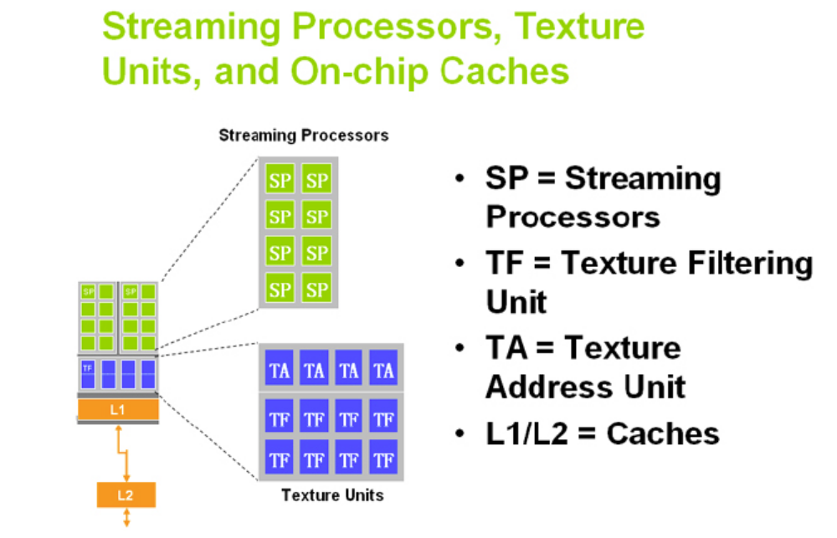

Slide 36
Texture Blocking
6D Organization
Cache Size
Cache Line Size
4x4 blocks
4x4 texels
(s1,t1)
(s2,t2)
(s3,t3)
Address
base
s1
t1
s2
t2
s3
t3
Source: Pat Hanrahan
Notes:
Inner block equal to cache line size to efficiently match granularity of memory access
Middle block size equal to cache size to minimize conflict misses
Build this up.

Slide 37
Direct3D 10 System and
NVIDIA GeForce 8800 GPU

Slide 38
Overview
Before graphics-programming APIs were introduced, 3D applications issued their commands directly to the graphics hardware
  Fast
  Became infeasible with increasing graphics hardware
Graphics APIs like DirectX and OpenGL act as a middle layer between the application and the graphics hardware
Using this model, applications write one set of code and the API does the job of translating this code to instructions that can be understood by the underlying hardware
A product of detailed collaboration among
  Application developers
  Hardware designers
  API/runtime architects

Slide 39
Problems with Earlier Versions
High state-change overhead
  Changing state (in terms of vertex formats, textures, shaders, shader parameters, blending modes etc.) incurs a high overhead
Excessive variation in hardware accelerator capabilities
Frequent CPU and GPU synchronization
  Generating new vertex data or building a cube map requires more communication, reducing efficiency
Instruction type and data type limitations
  Neither vertex nor pixel shader supports integer instructions
  Pixel shader accuracy for FP arithmetic can be improved
Resource Limitations
  The resources sizes were modest
  Algorithms had to be scaled back or broken into several passes

Slide 40
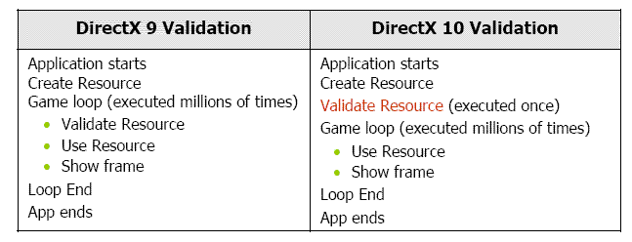
Main Features of DirectX 10
Main objective is to reduce CPU overhead
Some of the key changes are:
  Faster and cleaner runtime
    Programmable pipeline is directed using a low-level abstraction layer
    called Runtime. It hides the differences between varying applications and provides device-independent resource management
    The runtime of DirectX 10 has been redesigned to work more closely with the graphics hardware
    The GeForce 8800 architecture has been designed keeping in mind the changes in Runtime
    Treatment of validation enhances performance

Slide 41
Main Features of DirectX 10
    New Data Structure for Texture
      Switching between multiple textures causes high state-change cost
      DirectX 9 used to use texture atlas : but the approach was limited to 4096x4096 and resulted in incorrect filtering at texture boundaries
      DirectX 10 uses texture array : up to 512 textures can be stored sequentially
      Texture resolution extended to 8192x8192
      Maximum number of textures a shader can use is 128 (was 16)
      The instructions handling this array are executed by GPU
    Predicted Draw
      Complex objects are first drawn using a simple box approximation. If drawing the box has no effect on the final image, the complex object is not drawn at all. This is also known as an occlusion query
      With DirectX 10, this process is done entirely on the GPU, eliminating all CPU intervention

Slide 42
Main Features of DirectX 10
  Stream Out
    The vertex or geometry shader can output their results directly into graphics memory, bypassing the pixel shader
    Result can be iteratively processed in the GPU only
  State Object
    State management must be done in low cost
    Huge range of states in DirectX 9 is consolidated into 5 state objects: InputLayout, Sampler, Rasterizer, DepthStencil, Blend
    State changes that previously required multiple commands now need a single call

Slide 43
Main Features of DirectX 10
  Constant Buffers
    Constants are pre-defined values used as parameters in all shader programs
    Constants often require updating to reflect world changes
    Constant update produce significant API overhead
    DirectX 10 updates constants in batch mode
  New HDR Formats
    R11G11B10
    RGBE
    Offer same dymamic range as FP16, but takes half storage
    Max limit is 32 bits per color component : 8800 supports this high-precision rendering

Slide 44
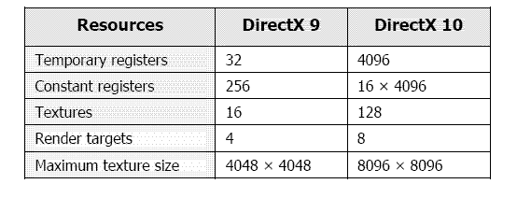
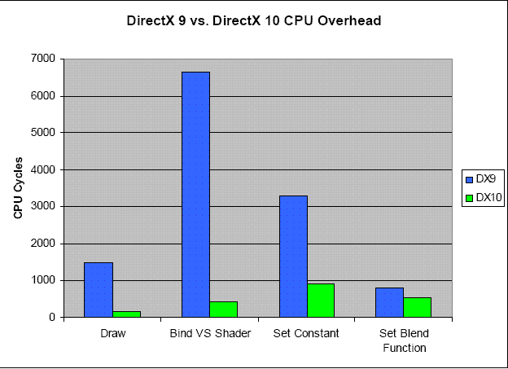
Quick Comparison to DirectX 9

Slide 45
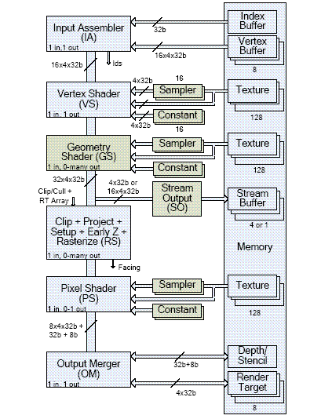
The Pipeline
Input Assembler
Vertex Shader
Geometry Shader
Stream Output
Set-up and Rasterization stage
Pixel Shader
Output Merger

Slide 46
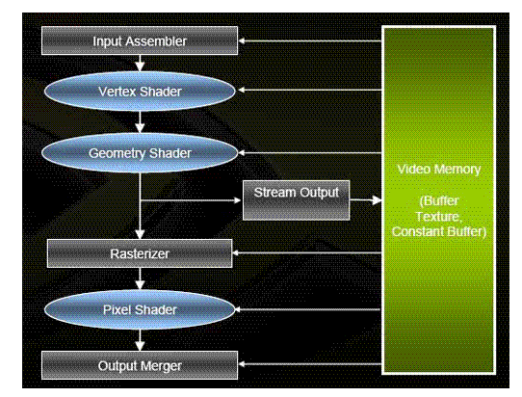
A Simplified Diagram

Slide 47
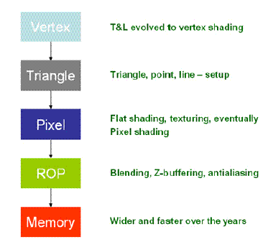
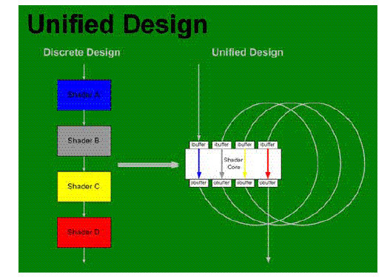
Relation to 8800 GPU
The pipeline can make efficient use of Unified Shader Architecture of 8800 GPU

Slide 48
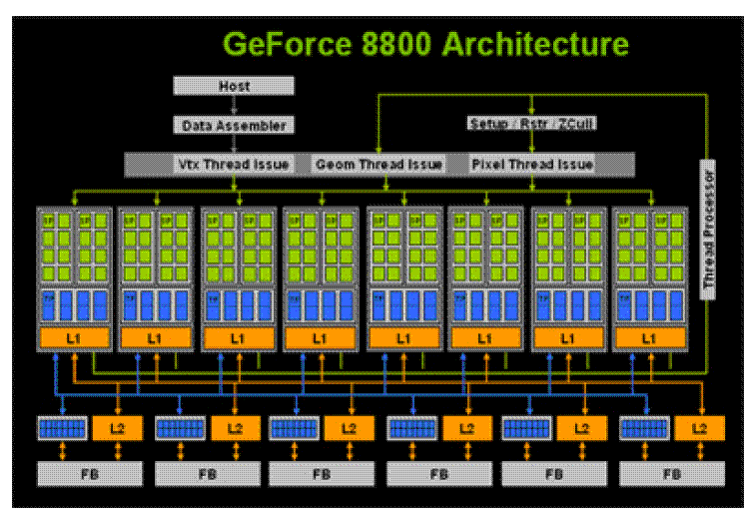
8800 GPU Architecture

Slide 49
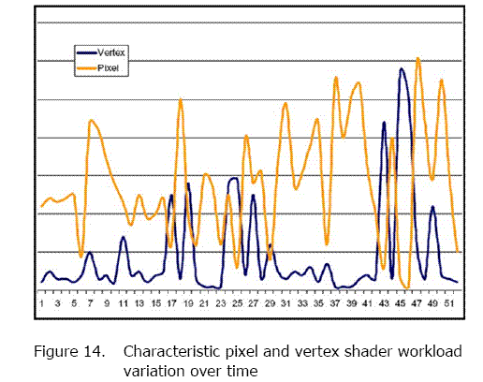
Unified Shader Architecture

Slide 50
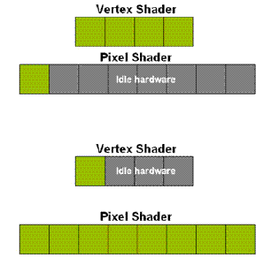

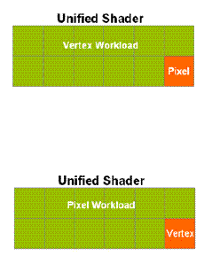
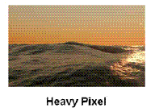
Unified Shader Architecture
Fixed Shader Unified Shader

Slide 51
Back to Pipeline : Input Assembler
Takes in 1D vertex data from up to 8 input streams
Converts data to a canonical format
supports a mechanism that allows the IA to effectively replicate an object n times - instancing

Slide 52
Vertex Shader
Used to transform vertices from object space to clip space.
Reads a single vertex and produces a single vertex as output
VS and other programmable stages share a common feature set that includes an expanded set of floating-point, integer, control, and memory read instructions allowing access to up to 128 memory buffers (textures) and 16 parameter (constant) buffers - common core

Slide 53
Geometry Shader
Takes the vertices of a single primi-tive (point, line segment, or triangle) as input and generates the vertices of zero or more primitives
Triangles and lines are output as connected strips of vertices
Additional vertices can be generated on-the-fly , allowing displacement mapping
Geometry shader has the ability to access the adjacency information
This enables implementation of some new powerful algorithms :
  Realistic fur rendering
  NPR rendering

Slide 54
Stream Output
Copies a subset of the vertex informa-tion to up to 4 1D output buffers in sequential order
Ideally the output data format of SO should be identical to the input data format of IA
But practically SO writes 32 bit data type while IA reads 8 or 16 bit
Data conversion and packing can be implemented by a GS program

Slide 55
Relation to 8800 GPU
Key to the GeForce 8800 architecture is the use of numerous scalar stream processors (SPs)
Stream processors are highly efficient computing engines that perform calculations on an input stream and produces an output stream that can be used by other stream processors
Stream processors can be grouped in close proximity, and in large numbers, to provide immense parallel processing power.

Slide 56
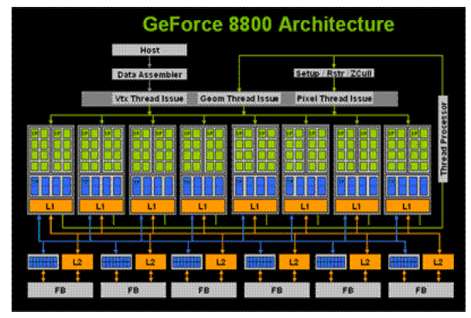
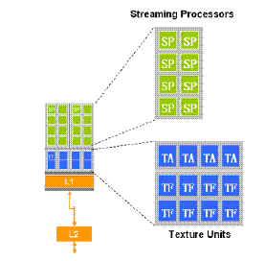
Stream Processing Architecture

Slide 57
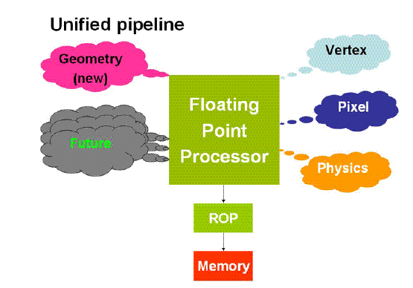
Unified FP Processor

Slide 58
Set-up and Rasterization Stage
Input to this stage is vertices
Output from this stage is a series of pixel fragments
Handles following operations:
  Clipping
  Culling
  Perspective divide
  View port transform
  Primitive set-up
  Scissoring
  Depth offset
  Depth processing like hierarchical-z
  Fragment generation

Slide 59
Pixel Shader
Input is a single pixel fragment
Produces a single output fragment consisting of 1-8 attribute values and an optional depth value
If the fragment is supposed to be rendered, its output to 8 render targets
Each target represent a different representation of the scene

Slide 60
Output Merger
Input is a fragment from the pixel shader
Performs traditional stencil and depth testing
Uses a single unified depth/stencil buffer to specify the bind points for this buffer and 8 other render targets
Degree of multiple rendering enhanced to 8

Slide 61
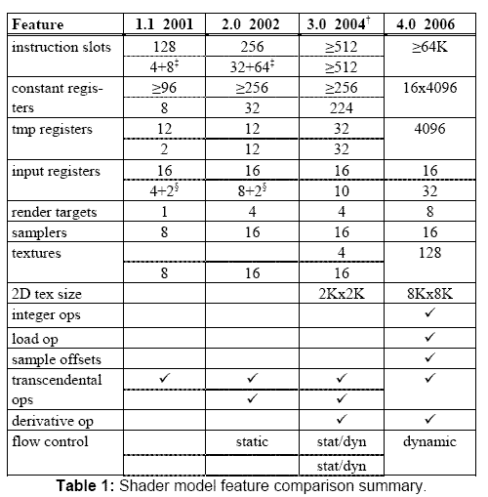
Shader Model 4.0

Slide 62
Architectural Changes in
Shader Model 4.0
In previous models, each programmable stage of the pipeline used separate virtual machines
Each VM had its own
  Instruction set
  General purpose registers
  I/O registers for inter-stage communication
  Resource binding points for attaching memory resources

Slide 63
Architectural Changes in
Shader Model 4.0
Direct3D 10 defines a single common core virtual machine as the base for each of the programmable stages
In addition to the previous resources, it also has:
  32-bit integer (arithmetic, bitwise, and conversion) instructions
  Unified pool of general purpose and indexable registers (4096x4)
  Separate unfiltered and filtered memory read instructions (load and sample instructions)
  Decoupled texture bind points (128) and sampler state (16)
  Shadow map sampling support • multiple banks (16) of constant (parameter) buffers (4096x4)

Slide 64
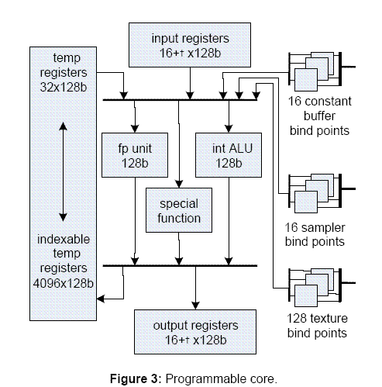
Diagram

Slide 65
Advantages of Shader Model 4.0
VM is close to providing all of the arithmetic, logic and flow control constructs available on a CPU
Resources have been substantially increased to meet the market demand for several years
With increasing resource consumption, hardware implementations are expected to degrade linearly, not fall rapidly
Can handle increase in constant storage as well as efficient update of constants
  The observation that groups of constants are updated at different frequencies
  So they partition the constant store into different buffers
The data representation, arithmetic accuracy and behavior is more rigorously specified – they follow IEEE 754 single precision floating point representation where it is possible

Slide 66
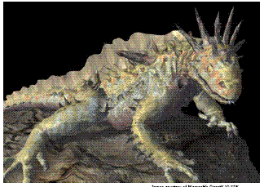
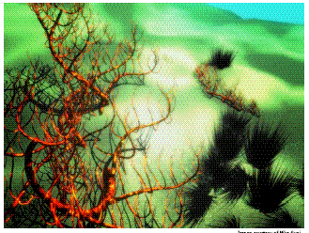
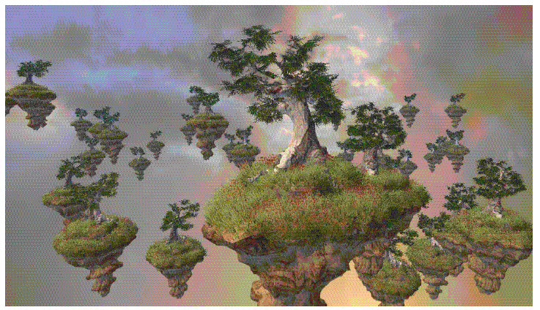
Power of DirectX 10
  Next Generation Effects
    Next-Generation Instancing
    Per-pixel Displacement Mapping
    Procedural Growth Simulation

Slide 67
Conclusions
A large step forward
Particularly geometry shader and stream output should become rich source of new ideas
Future work is directed to handle the growing bottleneck in content production

Slide 68
Introduction to the graphics pipeline of the PS3
: : Cedric Perthuis

Slide 69
Introduction
An overview of the hardware architecture with a focus on the graphics pipeline, and an introduction to the related software APIs
Aimed to be a high level overview for academics and game developers
No announcement and no sneak previews of PS3 games in this presentation

Slide 70
Outline
Platform Overview
Graphics Pipeline
APIs and tools
Cell Computing example
Conclusion

Slide 71
Platform overview
Processing
  3.2Ghz Cell: PPU and 7 SPUs
    PPU: PowerPC based, 2 hardware threads
    SPUs: dedicated vector processing units
  RSX®: high end GPU
Data flow
  IO: BluRay, HDD, USB, Memory Cards, GigaBit ethernet
  Memory: main 256 MB, video 256 MB
  SPUs, PPU and RSX® access main via shared bus
  RSX® pulls from main to video

Slide 72
PS3 Architecture
XDRAM
256 MB
Cell
3.2 GHz
20GB/s
RSX®
HD/HD
SD
AV out
25.6GB/s
15GB/s
2.5GB/s
22.4GB/s
GDDR3
256 MB
2.5GB/s
I/O
Bridge
BD/DVD/CD
ROM Drive
54GB
BT Controller
USB 2.0 x 6
Gbit Ether/WiFi
Removable Storage
MemoryStick,SD,CF

Slide 73
Focus on the Cell SPUs
The key strength of the PS3
  Similar to PS2 Vector Units, but order of magnitude more powerful
  Main Memory Access via DMA: needs software cache to do generic processing
  Programmable in C/C++ or assembly
  Programs: standalone executables or jobs
Ideal for sound, physics, graphics data preprocessing, or simply to offload the PPU

Slide 74
The Cell Processor
SPE₁
SPE₃
SPE₅
I/O
MIC
Memory
Interface
Controller
XIO
LS
(256KB)
LS
(256KB)
LS
(256KB)
Flex-
IO₁
I/O
DMA
DMA
DMA
PPE
SPE₀
SPE₂
SPE₄
SPE₆
Flex-
IO₀
I/O
L1 (32 KB I/D)
LS
(256KB)
LS
(256KB)
LS
(256KB)
LS
(256KB)
L2
(512 KB)
DMA
DMA
DMA
DMA

Slide 75
The RSX® Graphics Processor
Based on a high end NVidia chip
  Fully programmable pipeline: shader model 3.0
  Floating point render targets
  Hardware anti-aliasing ( 2x, 4x )
  256 MB of dedicated video memory
PULL from the main memory at 20 GB/s
HD Ready (720p/1080p)
  720p = 921 600 pixels
  1080p = 2 073 600 pixels
  ➔ a high end GPU adapted to work with the Cell Processor and HD displays

Slide 76
The RSX® parallel pipeline
Command processing
  Fifo of commands, flip and sync
Texture management
  System or video memory
  storage mode, compression
Vertex Processing
  Attribute fetch, vertex program
Fragment Processing
  Zcull, Fragment program, ROP

Slide 77
Xbox 360
512 MB system memory
IBM 3-way symmetric core processor
ATI GPU with embedded EDRAM
12x DVD
Optional Hard disk

Slide 78

The Xbox 360 GPU
Custom silicon designed by ATi Technologies Inc.
500 MHz, 338 million transistors, 90nm process
Supports vertex and pixel shader version 3.0+
  Includes some Xbox 360 extensions
Notes:
©2004 Microsoft Corporation. All rights reserved.
This presentation is for informational purposes only. Microsoft makes no warranties, express or implied, in this summary.

Slide 79
The Xbox 360 GPU
10 MB embedded DRAM (EDRAM) for extremely high-bandwidth render targets
  Alpha blending, Z testing, multisample antialiasing are all free (even when combined)
Hierarchical Z logic and dedicated memory for early Z/stencil rejection
GPU is also the memory hub for the whole system
  22.4 GB/sec to/from system memory
Notes:
©2004 Microsoft Corporation. All rights reserved.
This presentation is for informational purposes only. Microsoft makes no warranties, express or implied, in this summary.

Slide 80


More About the Xbox 360 GPU
48 shader ALUs shared between pixel and vertex shading (unified shaders)
  Each ALU can co-issue one float4 op and one scalar op each cycle
  Non-traditional architecture
16 texture samplers
Dedicated Branch instruction execution
Notes:
©2004 Microsoft Corporation. All rights reserved.
This presentation is for informational purposes only. Microsoft makes no warranties, express or implied, in this summary.

Slide 81
More About the Xbox 360 GPU
2x and 4x hardware multi-sample anti-aliasing (MSAA)
Hardware tessellator
  N-patches, triangular patches, and rectangular patches
Can render to 4 render targets and a depth/stencil buffer simultaneously
Notes:
©2004 Microsoft Corporation. All rights reserved.
This presentation is for informational purposes only. Microsoft makes no warranties, express or implied, in this summary.

Slide 82
GPU: Work Flow
Consumes instructions and data from a command buffer
  Ring buffer in system memory
  Managed by Direct3D, user configurable size (default 2 MB)
  Supports indirection for vertex data, index data, shaders, textures, render state, and command buffers
Up to 8 simultaneous contexts in-flight at once
  Changing shaders or render state is inexpensive, since a new context can be started up easily
Notes:
©2004 Microsoft Corporation. All rights reserved.
This presentation is for informational purposes only. Microsoft makes no warranties, express or implied, in this summary.

Slide 83
GPU: Work Flow
Threads work on units of 64 vertices or pixels at once
Dedicated triangle setup, clipping, etc.
Pixels processed in 2x2 quads
Back buffers/render targets stored in EDRAM
  Alpha, Z, stencil test, and MSAA expansion done in EDRAM module
EDRAM contents copied to system memory by “resolve” hardware
Notes:
©2004 Microsoft Corporation. All rights reserved.
This presentation is for informational purposes only. Microsoft makes no warranties, express or implied, in this summary.

Slide 84


GPU: Operations Per Clock
Write 8 pixels or 16 Z-only pixels to EDRAM
  With MSAA, up to 32 samples or 64 Z-only samples
Reject up to 64 pixels that fail Hierarchical Z testing
Vertex fetch sixteen 32-bit words from up to two different vertex streams
Notes:
©2004 Microsoft Corporation. All rights reserved.
This presentation is for informational purposes only. Microsoft makes no warranties, express or implied, in this summary.

Slide 85
GPU: Operations Per Clock
16 bilinear texture fetches
48 vector and scalar ALU operations
Interpolate 16 float4 shader interpolants
32 control flow operations
Process one vertex, one triangle
Resolve 8 pixels to system memory from EDRAM
Notes:
©2004 Microsoft Corporation. All rights reserved.
This presentation is for informational purposes only. Microsoft makes no warranties, express or implied, in this summary.

Slide 86
GPU: Hierarchical Z
Rough, low-resolution representation of Z/stencil buffer contents
Provides early Z/stencil rejection for pixel quads
11 bits of Z and 1 bit of stencil per block
Notes:
©2004 Microsoft Corporation. All rights reserved.
This presentation is for informational purposes only. Microsoft makes no warranties, express or implied, in this summary.

Slide 87
GPU: Hierarchical Z
NOT tied to compression
  EDRAM BW advantage
Separate memory buffer on GPU
  Enough memory for 1280x720 2x MSAA
Provides a big performance boost when drawing complex scenes
  Draw opaque objects front to back
Notes:
©2004 Microsoft Corporation. All rights reserved.
This presentation is for informational purposes only. Microsoft makes no warranties, express or implied, in this summary.

Slide 88
GPU: Textures
16 bilinear texture samples per clock
  64bpp runs at half rate, 128bpp at quarter rate
  Trilinear at half rate
Unlimited dependent texture fetching
DXT decompression has 32 bit precision
  Better than Xbox (16-bit precision)
Notes:
©2004 Microsoft Corporation. All rights reserved.
This presentation is for informational purposes only. Microsoft makes no warranties, express or implied, in this summary.

Slide 89
GPU: Resolve
Copies surface data from EDRAM to a texture in system memory
Required for render-to-texture and presentation to the screen
Can perform MSAA sample averaging or resolve individual samples
Can perform format conversions and biasing
Notes:
©2004 Microsoft Corporation. All rights reserved.
This presentation is for informational purposes only. Microsoft makes no warranties, express or implied, in this summary.

Slide 90

Direct3D 9+ on Xbox 360
Similar API to PC Direct3D 9.0
Optimized for Xbox 360 hardware
  No abstraction layers or drivers—it’s direct to the metal
  Exposes all Xbox 360 custom hardware features
    New state enums
    New APIs for finer-grained control and completely new features
Notes:
©2004 Microsoft Corporation. All rights reserved.
This presentation is for informational purposes only. Microsoft makes no warranties, express or implied, in this summary.

Slide 91
Direct3D 9+ on Xbox 360
Communicates with GPU via a command buffer
  Ring buffer in system memory
Direct Command Buffer Playback support

Slide 92
Direct3D: Command Buffer
Code Execution
CPU Write Pointer
Rendering
Draw
Draw
Draw
Draw
GPU Read Pointer
Ring buffer that allows the CPU to safely send commands to the GPU
Buffer is filled by CPU, and the GPU consumes the data
Notes:
©2004 Microsoft Corporation. All rights reserved.
This presentation is for informational purposes only. Microsoft makes no warranties, express or implied, in this summary.
If the CPU gets too far ahead of the GPU, there is a stall
If the GPU catches up to the CPU, the GPU sits idle

Slide 93
Shaders
Two options for writing shaders
  HLSL (with Xbox 360 extensions)
  GPU microcode (specific to the Xbox 360 GPU, similar to assembly but direct to hardware)
Recommendation: Use HLSL
  Easy to write and maintain
  Replace individual shaders with microcode if performance analysis warrants it

